Slide 1
Predicting Totals in Powerlifting
Will Maher, Melissa Wright,
Kai Wu
Phase II

Slide 2
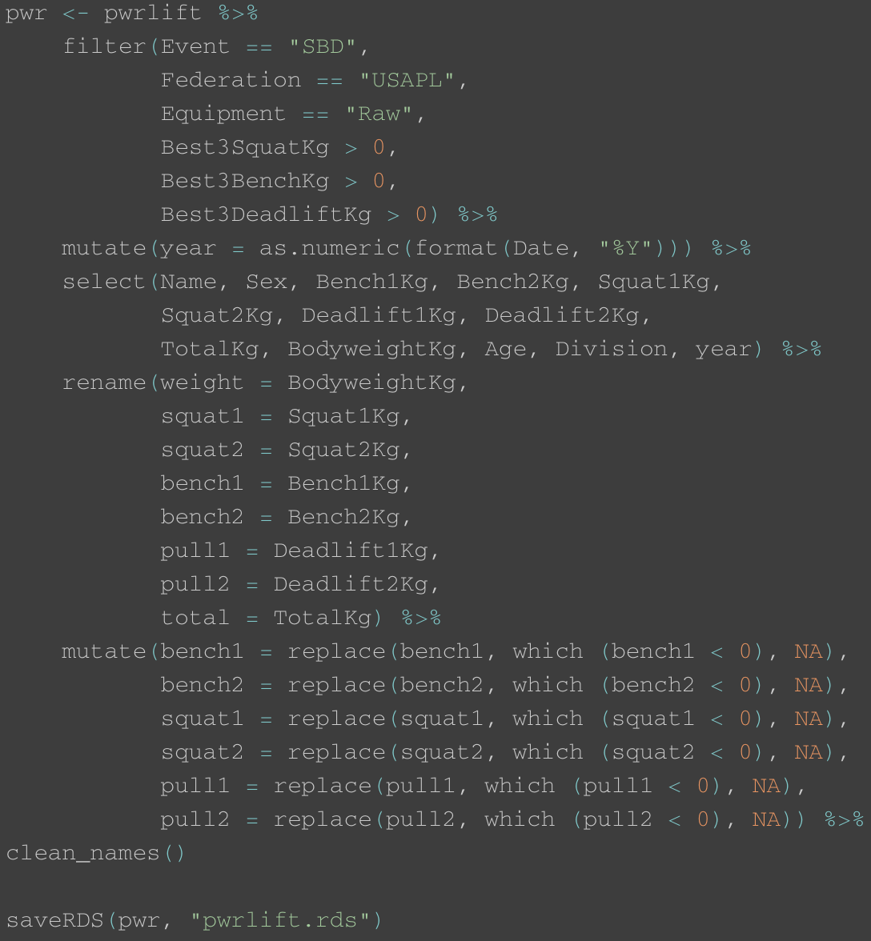
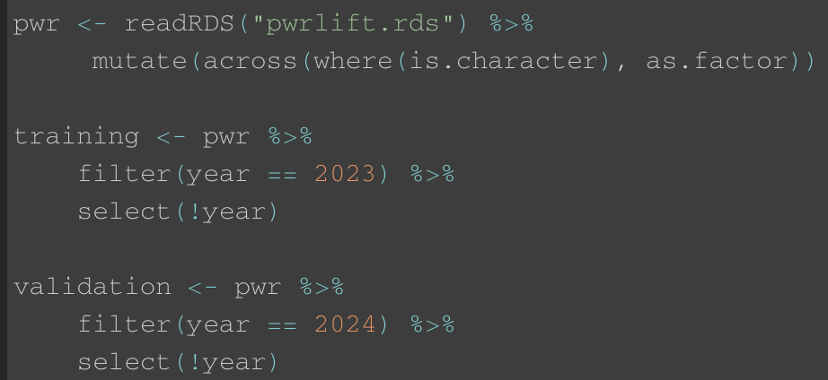
Data
Wrangling

Slide 3
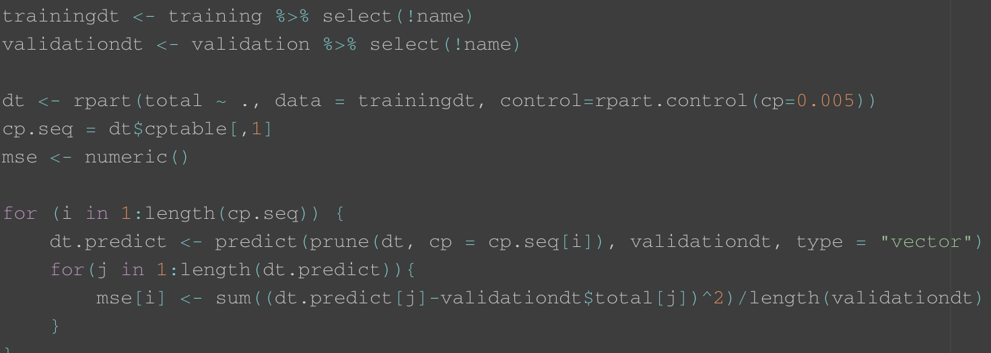
Initial Decision Tree
Cannot use misclassification, F-scores, or ROC curves. MSE used.

Slide 4
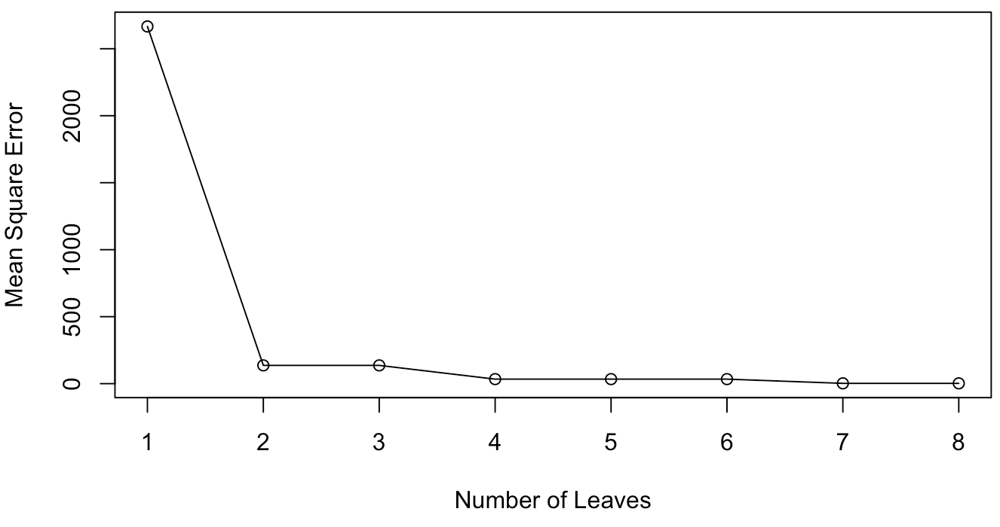

Slide 5
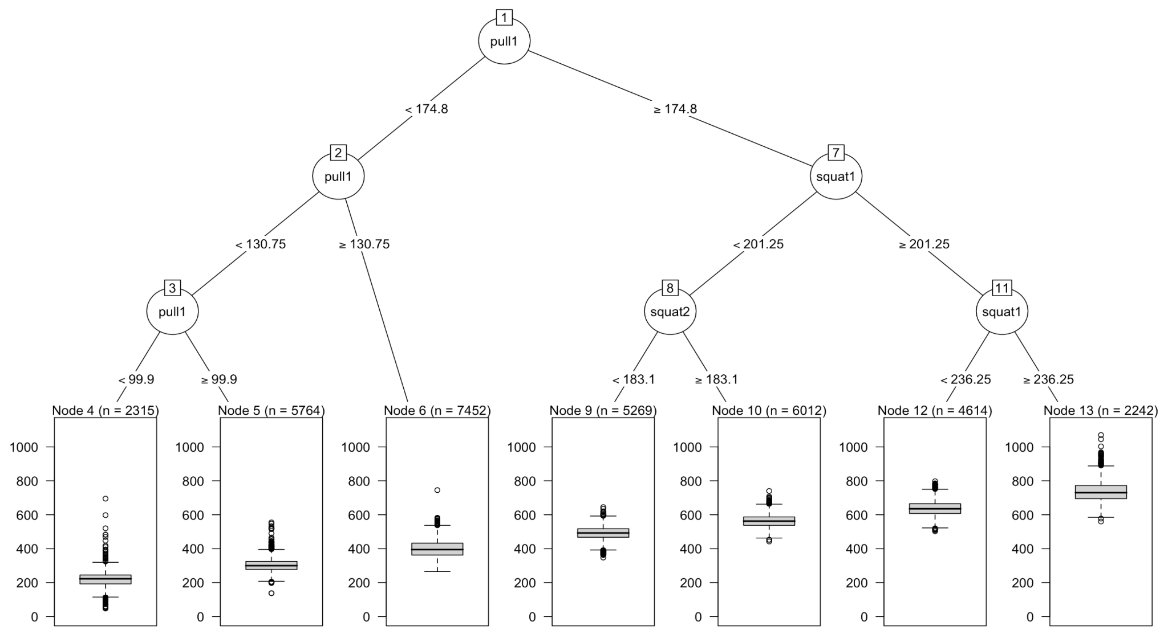

Slide 6
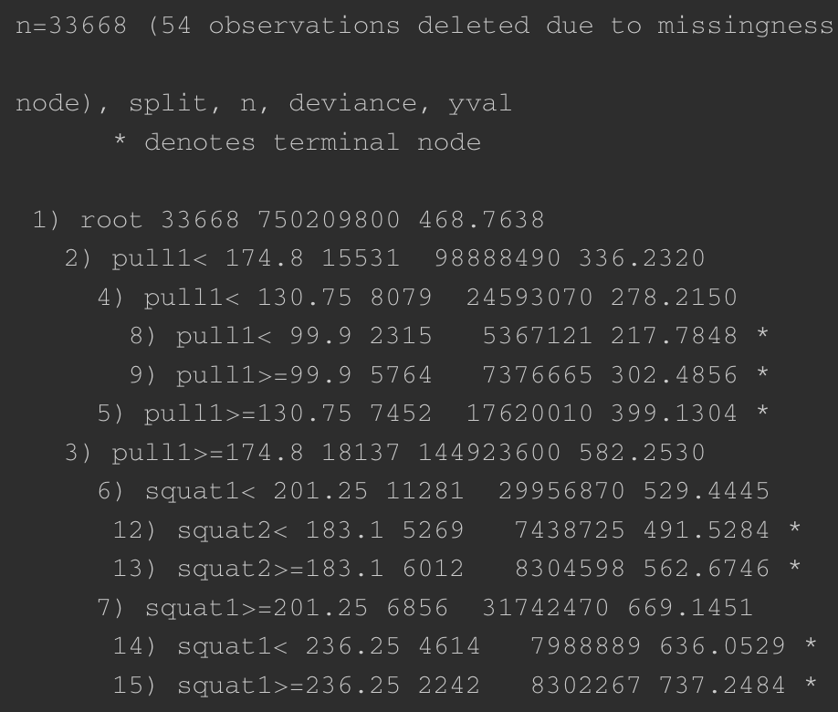
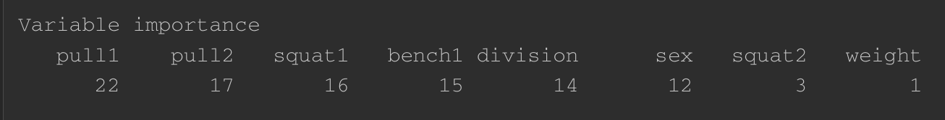
Final Decision Tree
What we expected:
Deadlift to have the most importance
What we did not expect:
Division to have high importance
Gender and especially body weight to have low importance
Extremely high deviance despite low target variable range. Possibly due to complexity and variability or missing information

Slide 7
Ridge vs Lasso
Ridge prevents overfitting by adding a penalty term, the L2 Regularization Term
Shrinks coefficients towards 0 but does not force them to exactly 0
Tuning parameter lambda controls shrinkage of coefficients
Lasso prevents overfitting penalizing the absolute value of the magnitude of the coefficients
Tuning parameter lambda controls strength of regularization
As coefficients are pushed toward 0, a larger alpha leads to more shrinkage

Slide 8
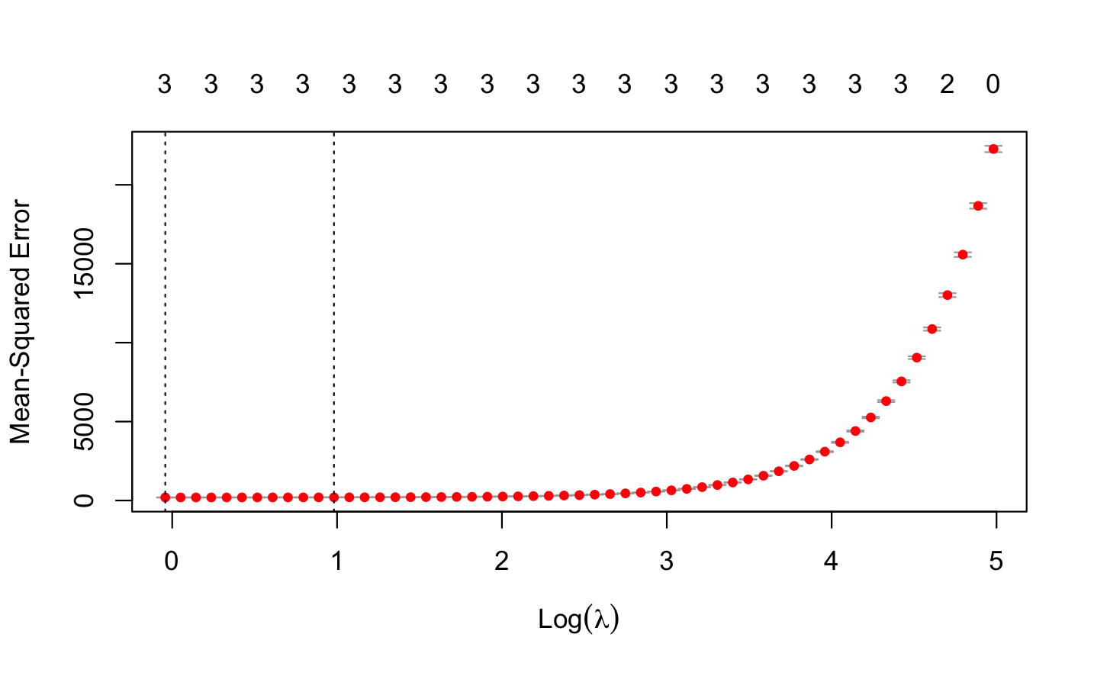
Lasso Regression
Optimal Lambda | 0.9586
Intercept | 26.315
Squat1 | 1.013
Bench1 | 1.179
Deadlift1 | 0.987

Slide 9
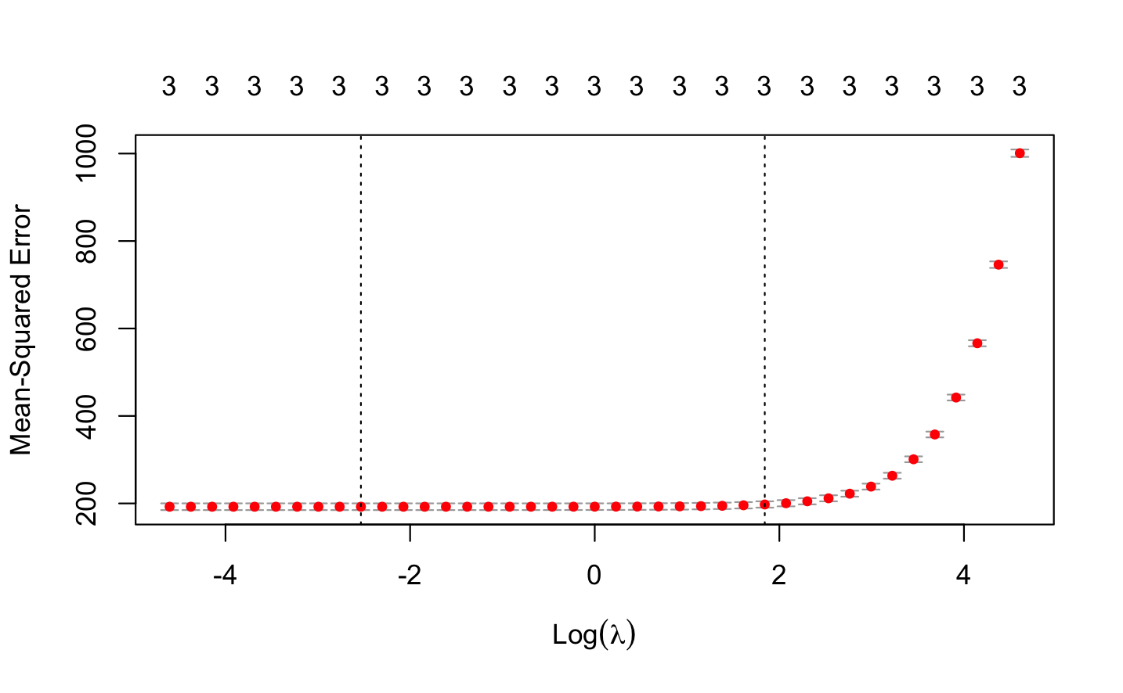
Ridge Regression
Optimal Lambda | 0.032
Intercept | 23.48
Squat1 | 1.020
Bench1 | 1.193
Deadlift1 | 0.989

Slide 10
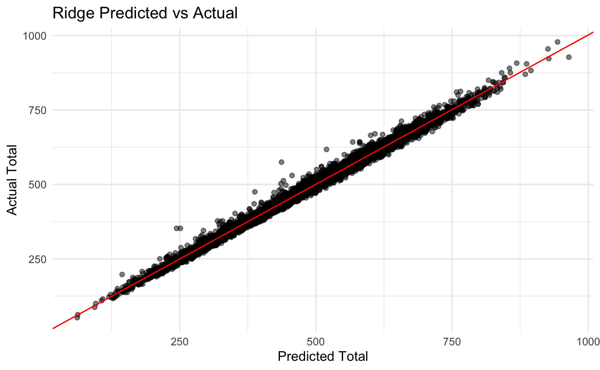
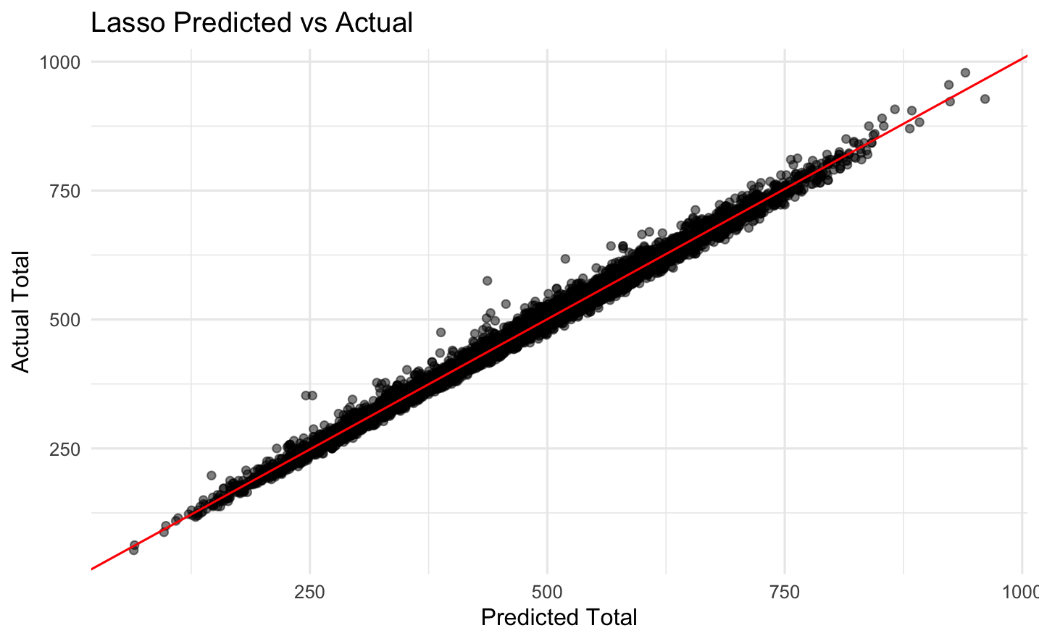
Regression Model Assessment
Ridge Validation MSE: 185.729
Lasso Validation MSE: 187.729

Slide 11
Predicting on a 2024 Competitor
Athletes Opening Numbers
Squat: 120 kg
Bench: 60 kg
Deadlift: 150 kg
Predicted Total
Lasso: 366.67 kg
Ridge: 365.85 kg
Actual Total
370 kg

Slide 12
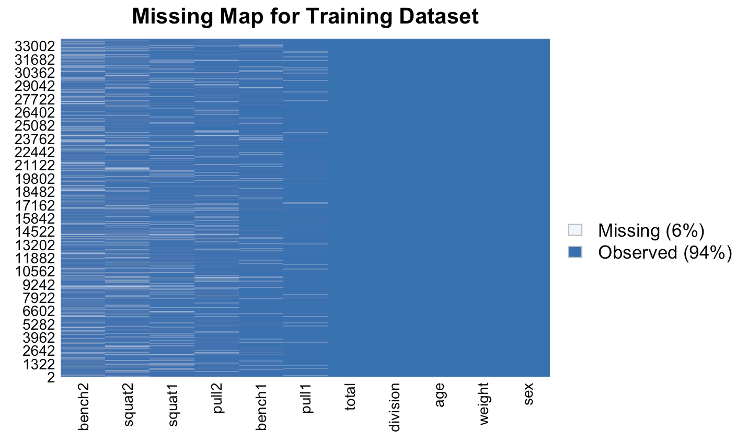
Missing Values for Random Forest
Variables | NA Proportion
Bench 1 | 0.06648479
Bench 2 | 0.1590653
Squat 1 | 0.1050353
Squat 2 | 0.1369729
Pull 1 | 0.041338
Pull 2 | 0.09782931
Total Kg | 0.001601329

Slide 13
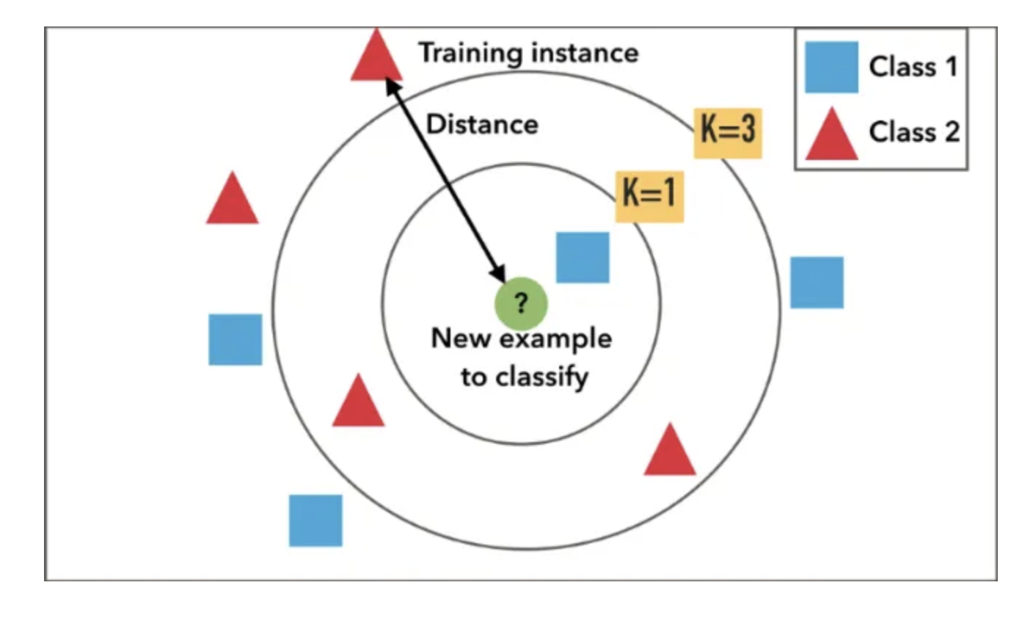
Imputation by K-Nearest Neighbors
Introduction to KNN :
Non-parametric method, commonly used in classification and regression tasks;
It is purely data-driven and sensitive to the local structure of the data;
It classifies a point based on the majority labels of its k nearest neighbors in the training dataset. For regression, it predicts the value based on the average of the values of its k nearest neighbors.
Why KNN?
Easy to implement and understand
Lazy learning and no assumptions
Miss Forest can be computationally intensive and less
transparent and MICE can be complex and requires
decisions on the form of imputation models for each variable.

Slide 14
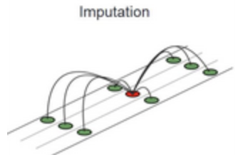
Imputation by K-Nearest Neighbors
Implementing KNN Imputation for Training Data :
# Preprocess the data, excluding 'division' and 'total' for imputation
test = preProcess(training %>% select(-c(division, total)), method = "knnImpute")
# Impute missing values
train.imp <- predict(test, training)
Replicating Imputation for Validation Data
Repeat the same preprocessing and imputation steps for the validation dataset to maintain methodological consistency, promoting reliable model evaluation and performance.

Slide 15
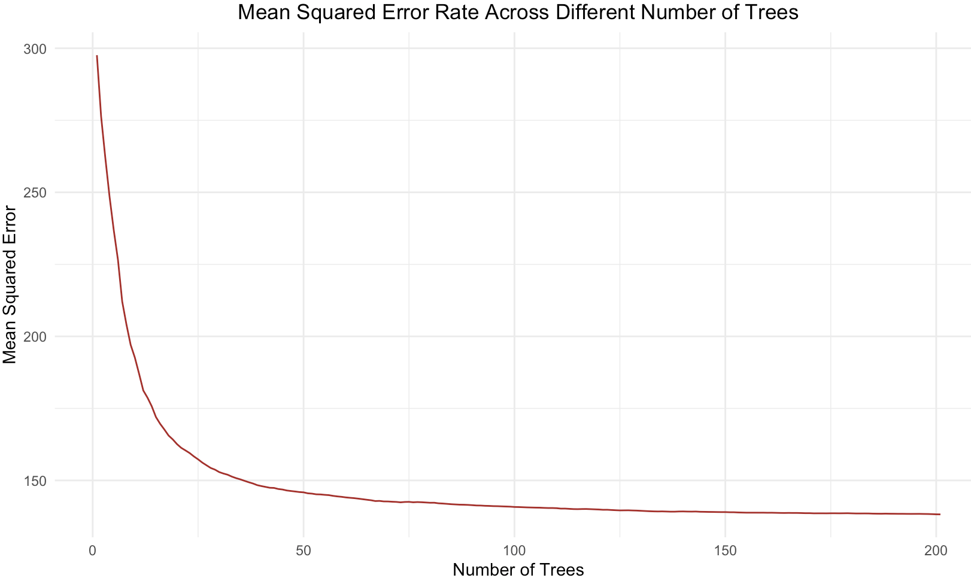
Random Forest Model Assessment
Model Type: Random Forest Regression
Number of Trees: 201
Variables Tried at Each Split: 3
Random Forest Model MSE = 139.3426
Percentage of Variance Explained: 99.38%

Slide 16
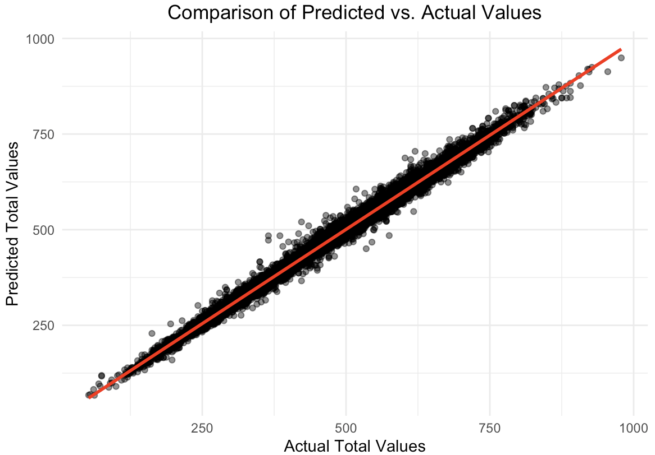
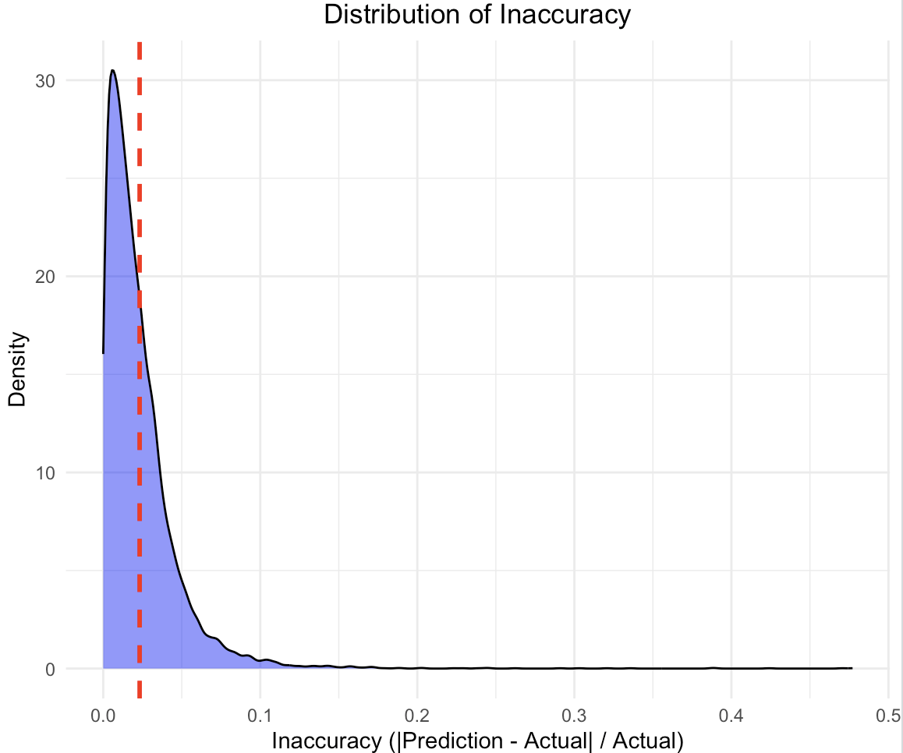
Prediction and Accuracy
Random Forest Model MSE = 139.3426

Slide 17
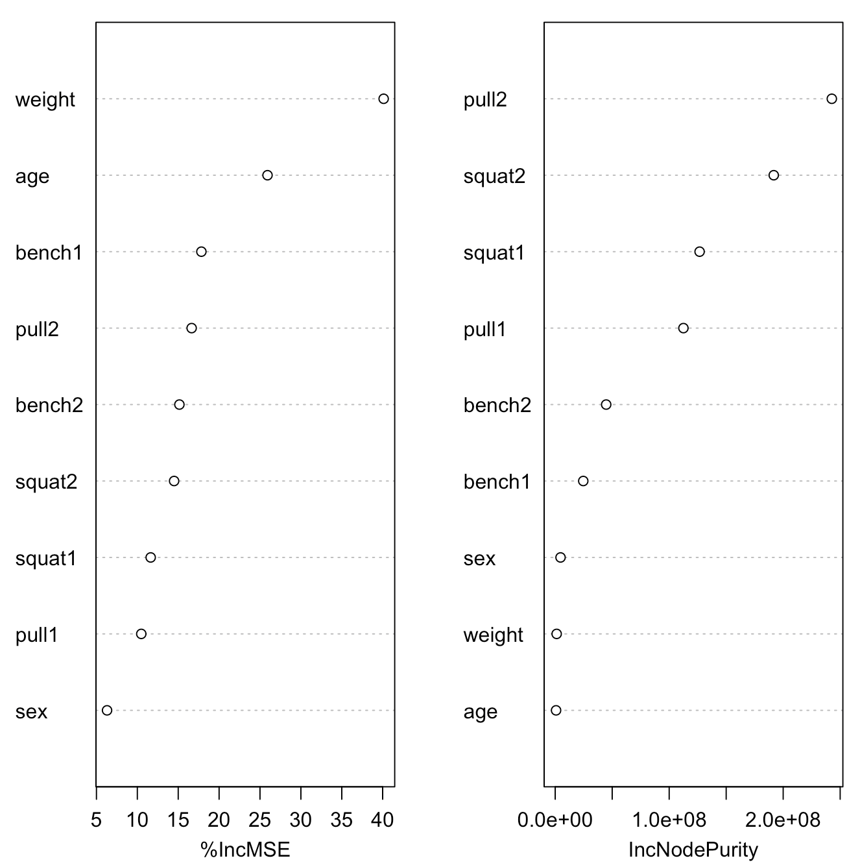
Variable Importance
Variables | %IncMSE | IncNodePurity
Sex | 17.74150 | 4676665
Bench 1 | 465.35312 | 24614122
Bench 2 | 1080.58265 | 44727846
Squat 1 | 1283.60703 | 126682573
Squat 2 | 3242.58153 | 191738691
Pull 1 | 1329.27972 | 112494683
Pull 2 | 4608.28476 | 242680313
Weight | 33.87424 | 1273024
Age | 18.31200 | 753181

Slide 18
Challenges
Decision tree by far had the lowest MSE at 2.26. This is not surprising, because decision trees can handle missing values and gender differences
Down-sampling is potentially ineffective, as lifters who miss either their first or second attempt are likely to have a lower total, as they will need to retry their failed weight in their next attempt. If we only include lifters who did not fail their first and second attempts in the model, then the model will be less accurate when testing on validation data.
Imputation is also difficult, because we cannot just replace NAs with the mean, median, or mode. There were also struggles with KNN imputation.

Slide 19
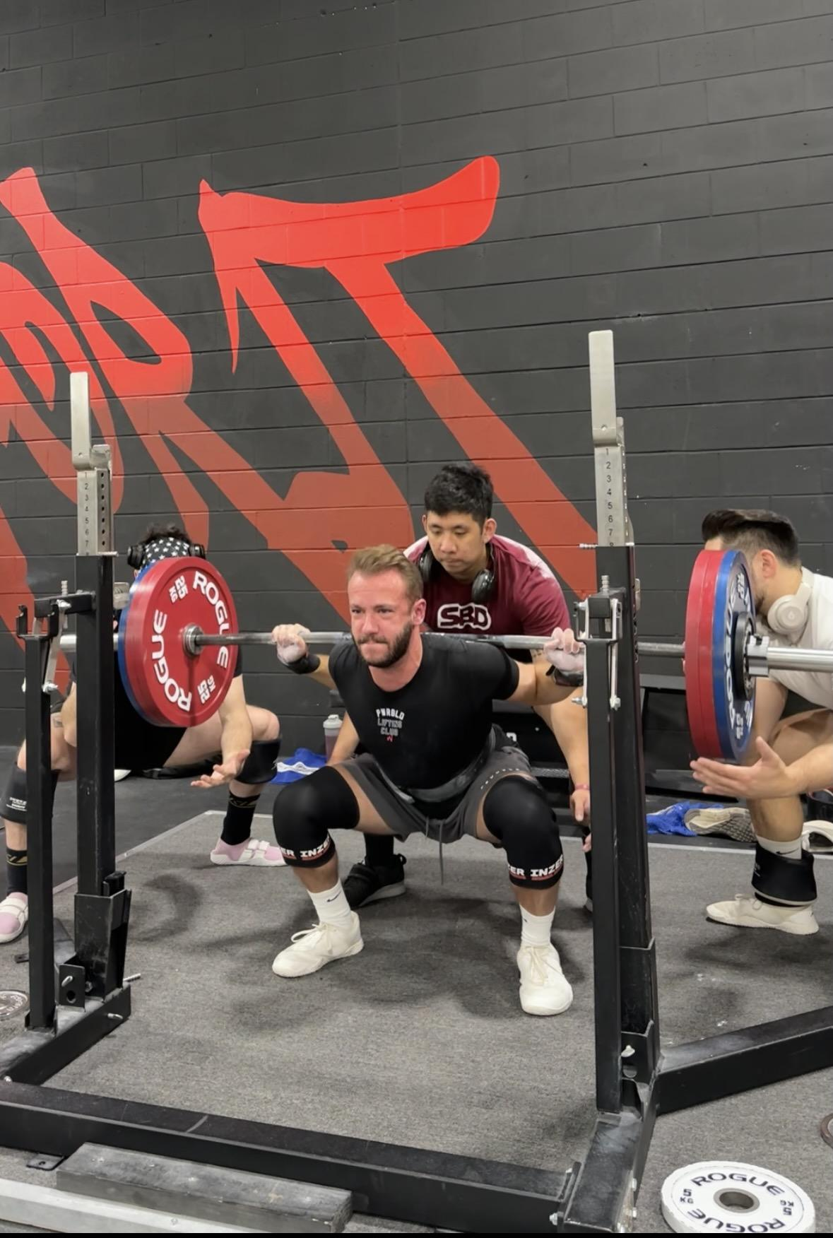
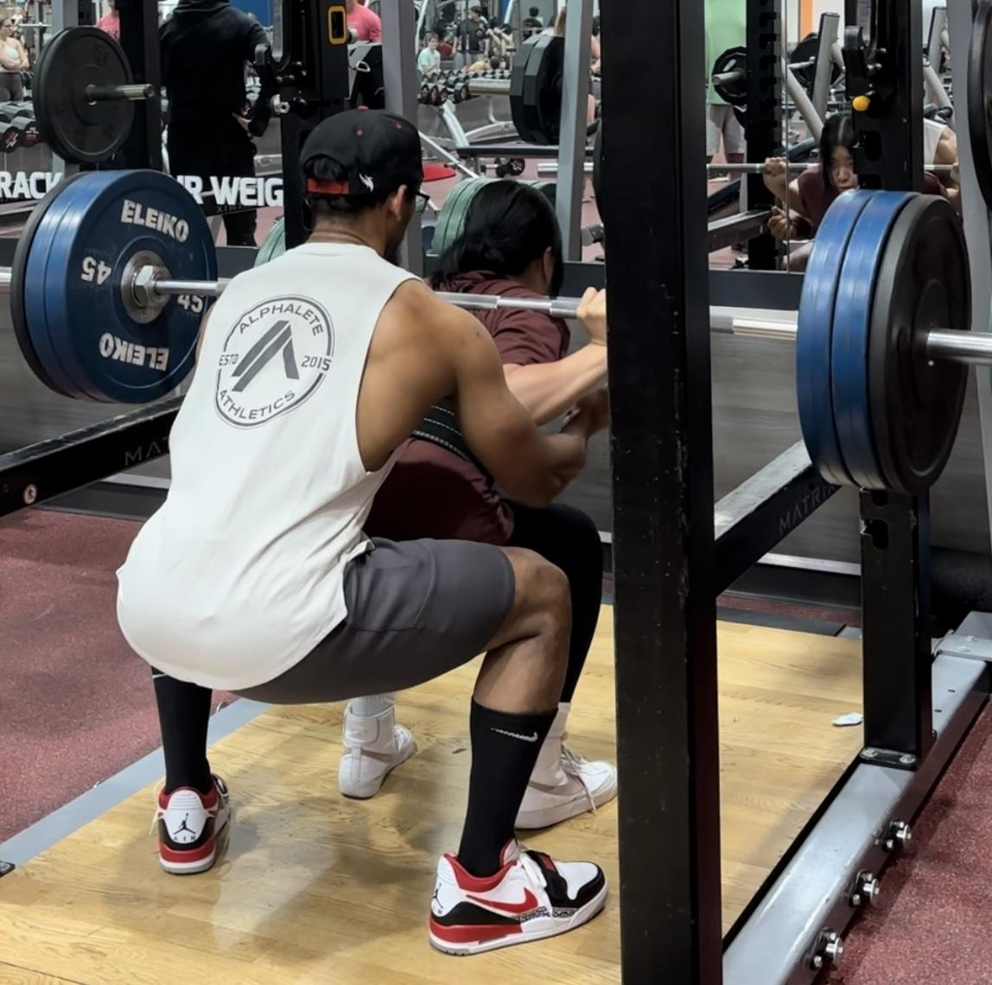
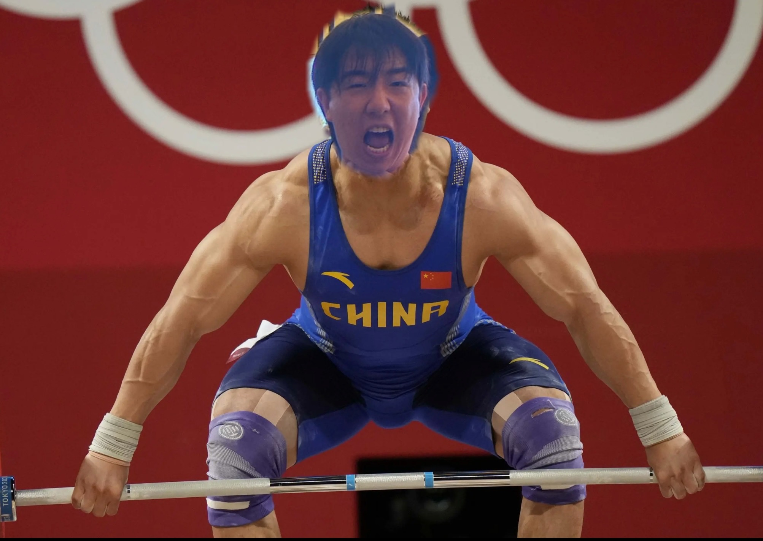
Thank You And Any Questions?

